Slide 1
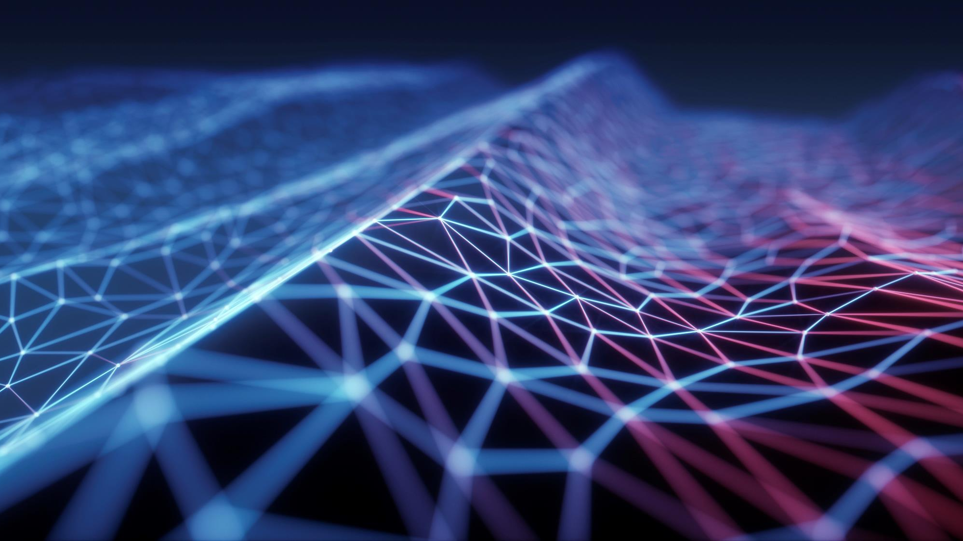
Networking protocols
Balayogi G

Slide 2
What is protocol?
A Protocol is a set of rules and guidelines for communicating data.
Rules are defined for each step and process during communication between two or more computers.
Networks have to follow these rules to successfully transmit data.

Slide 3
Types of protocols
Application layer protocols
Transport layer protocols
Internet layer protocols
Link Layer protocols

Slide 4
Application layer protocols
Application layer is responsible for the user interaction between the network and the user.
This layer is responsible fot,
How you present the data to the user?
To determine the resource availability
Data translation and data encryption and compression
Create, maintain, terminate the session for the transmission.

Slide 5
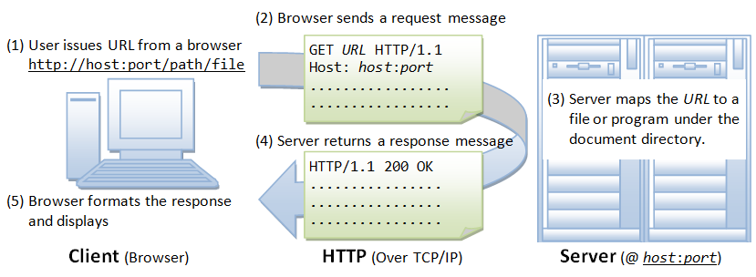
Application layer protocols
HTTP:
Http is Hyper text transfer protocol. Which is used to make communication between the web server and clients.
WWW is the combination of webservers and clients.
The communication between the web server and the clients will be done with the help of HTTP REQUEST and HTTP RESPONSE.
Example for the HTTP protocols are, web browsers.

Slide 6
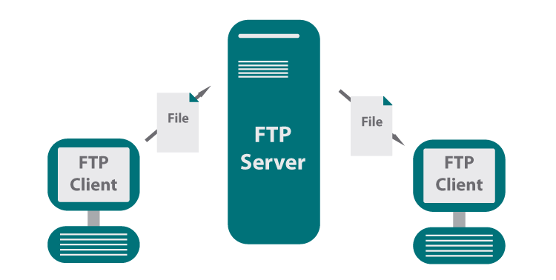
Application layer protocols
FTP:
FTP is File transfer protocol, which is used to transfer files between the system to system with the help of TCP/IP protocols.
In this Protocol, end user will request for a file to local or the FTP server. It will respond to that request.
Example for the FTP protocol are Google drive, Drop box and more.

Slide 7
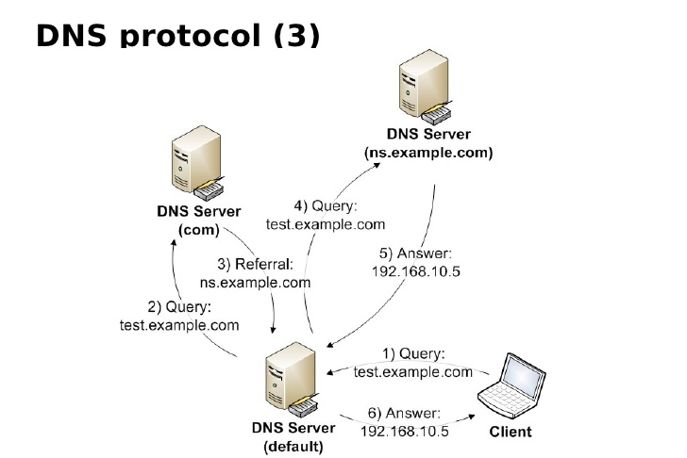
Application layer protocols
DNS:
DNS is Domain Name Server, used to resolve the human readable form of URL(Uniform Resource locator) to the numerical IP address.
This Protocol is used by all the user and the network devices when it needed to communicate with the website.
This protocol works with the help of the query and response method
When ever we need to communicate with any website we need DNS protocol.

Slide 8
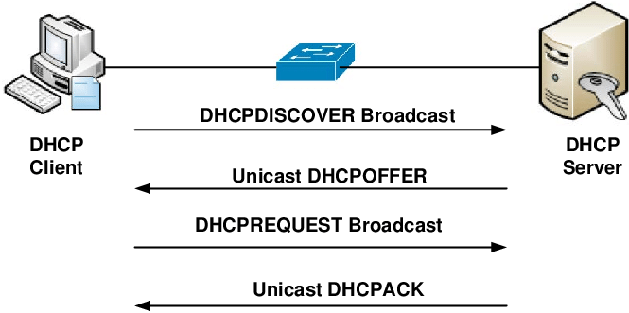
Application layer protocols
DHCP:
DHCP is Dynamic host configuration protocol, used to configure many devices within a milliseconds.
DHCP is mostly used in the enterprise networks which contains many networking devices.
DORA process is used in this protocol, D-Discover, O-Offer, R-Request, and A- Acknowledgement.

Slide 9
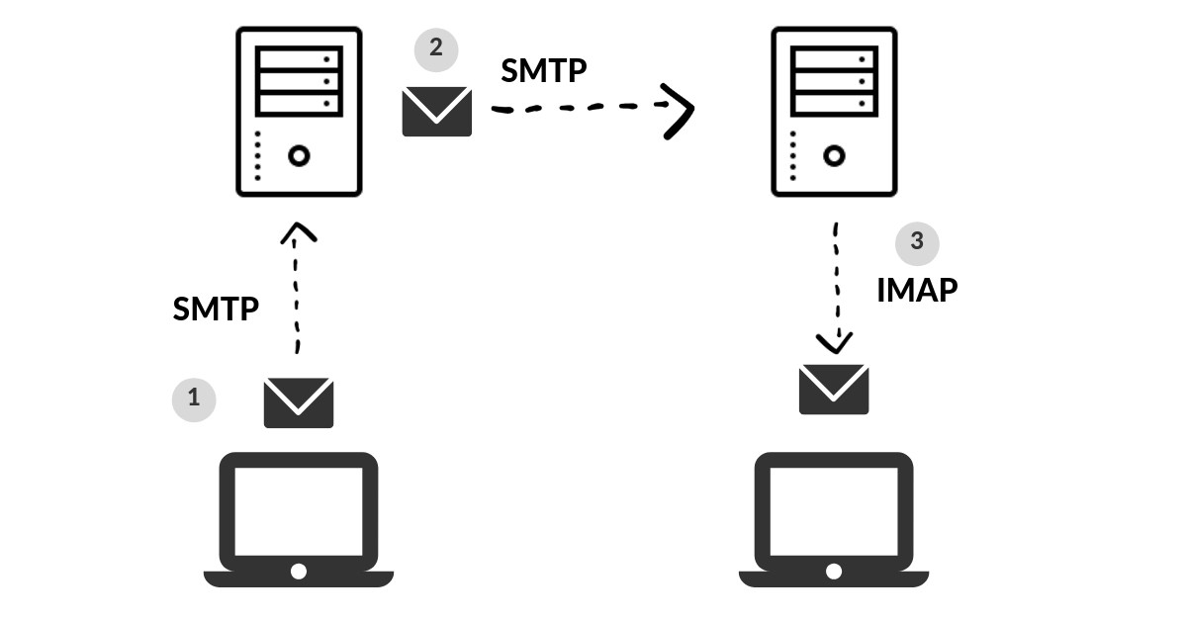
Application layer protocols
IMAP:
IMAP is Internet message access protocol, used to retrive the email from the mail server to the mail clients(user).
IMAP is designed to manage the email service for the multiple clients(users).
IMAP protocol worked with POP3 protocol in olden days for email retrival.
Example for IMAP protocols are Gmail, Yahoo Mail, Outlook , Proton Mail.

Slide 10
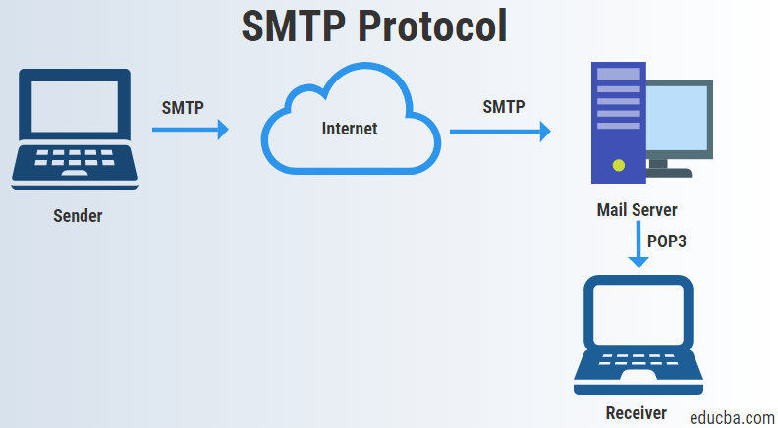
Application layer protocols
SMTP:
SMTP is Simple mail transfer protocol, used to send and receive the mails from Mail server.
SMTP are used in mostly by the proprietary systems like Microsoft exchange , Webmail use SMTP for sending emails.
Example for SMTP are Gmail, Outlook, and more.

Slide 11
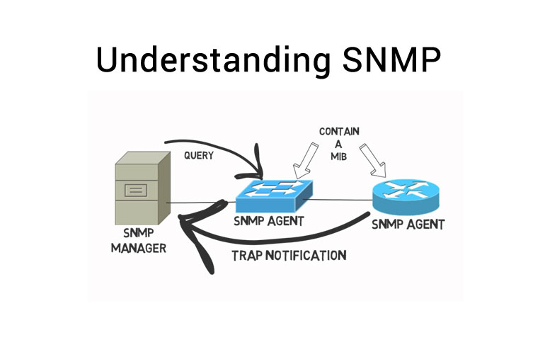
Application layer protocols
SNMP:
SNMP is simple network management protocol, used to manager the networking devices , networking device status and more,
SNMP protocol will collect the information about the Network devices present in the devices, this information includes behaviour change in the network devices.
We can set alerts to identify the status of the networking devices using SNMP protocol.

Slide 12
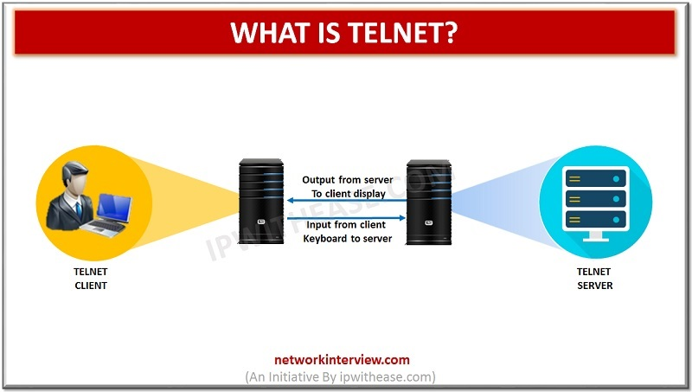
Application layer protocols
Telnet:
Telnet is TELecommunication NETwork, used to connect and communicate with the remote device.
Telnet is one of the important protocol in the application layer, with the help of this protocol we can able to communicate with any networking device in the world that are connected with the internet.
Telnet is mostly used in all the foreign based companies, we provide services to them by managing their resources.

Slide 13
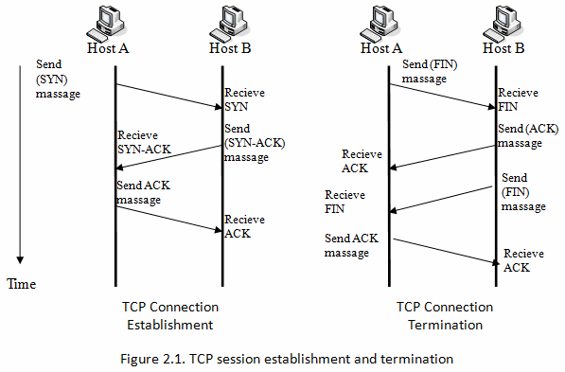
Transport layer protocols
TCP:
TCP is transmission control protocol, used to establish and manage the connection between the devices.
TCP is a connection oriented protocol, provide the services for the application layer to transmit data completely to the other device.
This protocol ensures the reliability of the transmission in the network.
This protocol establish connection before sending data to the other device
This protocol wait for the acknowledgement for the transmitted data.

Slide 14
Transport layer protocols
UDP:
UDP is User datagram protocol, used to establish and manage the connection between the devices.
UDP is a connection-less protocol, provide the services for the application layer to transmit data completely to the other device.
This protocol doesn’t provide reliability like TCP, but this contains built in reliability.
This protocol establish conncetion before sending data to the other device.
This protocol doesn’t wait for acknowledgemet for the transmitted data.

Slide 15
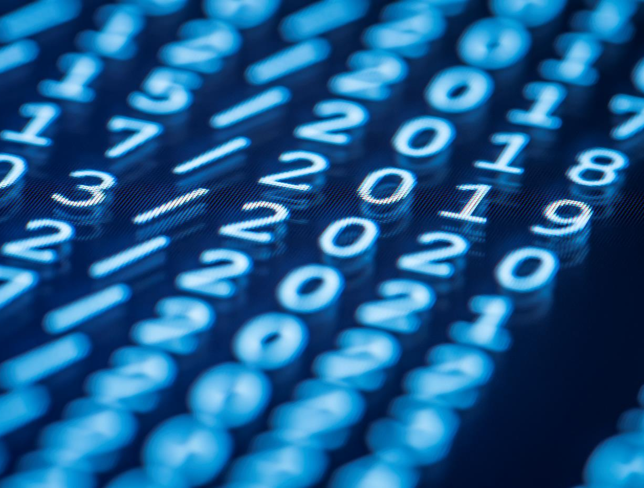
Thank You
someone@example.com

